Slide 1
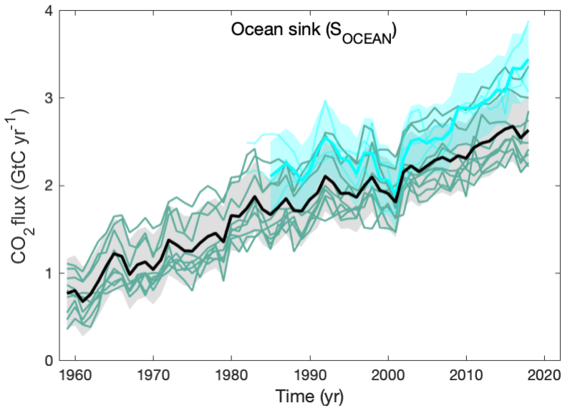
Global Carbon Data Management and Synthesis
PIs: Brendan Carter, Richard Feely, Rik Wanninkhof, and Kevin O’Brien
Ocean carbon content is measured millions of times annually by 15+ countries using numerous methods. The data produced is most useful to the global scientific community when it is available in consistently formatted datasets with well-characterized uncertainties.
PI tasks include:
measuring and obtaining data from foreign and domestic collaborators;
quality controlling data;
providing data in common, convenient, and accessible formats;
assessing data uncertainty;
interpreting data;
and communicating relevant findings to decision makers and the broader public.
Friedlingstein et al., 2018
Notes:
Rationale for Global Carbon Data Management and Synthesis activities:
Over the past two and a half centuries, the surface oceans have absorbed 25 to 34% of humankind’s carbon dioxide (CO₂) emissions, reducing the accumulation of greenhouse gases in the atmosphere and changing ocean chemistry. Monitoring and analyzing the ocean carbon cycle is critical for understanding how this anthropogenic CO₂ sink is functioning; how ocean carbon storage might change in the future; and how we can best anticipate, mitigate, and adapt to potential future changes.
Carbon data synthesis efforts are essential due to the global scale of ocean carbon uptake, the complexities of interpreting ocean carbon measurements, the variety of ways carbon content is measured, and the sheer volume of carbon measurements produced by the global research community. Research programs from 15+ participating nations contribute measurements of many different aspects of seawater chemistry made with a wide variety of sensors and analytical techniques. These diverse measurements are ultimately used with Earth System Model assessments, data-assimilating models, property budgets, and measurement inversions designed to address scientific questions related to ocean carbon uptake. A common element of all of these analyses is that they benefit from consistently-formatted ocean carbon measurements with well-constrained uncertainties. Data synthesis is therefore necessary to translate the wealth of information provided by the measurement community into the quality controlled and assessed data products needed for advancing and communicating global carbon cycle science.
On this slide we summarize PI tasks. The figure is from the Global Carbon Project’s annual Global Carbon Budget and is provided an example of a high end synthesis product that relies on the data products and data sets produced and refined by this effort. This figure shows the estimated ocean CO₂ sink over time, highlighting the variability and the long term increase in the ocean CO₂ sink. The pink line is from the SOCAT data product, which is a key product of DMSP scientist efforts, and it is compared to individual model ensemble runs (blue lines) and the mean ensemble value (black line with grey uncertainty envelope).

Slide 2
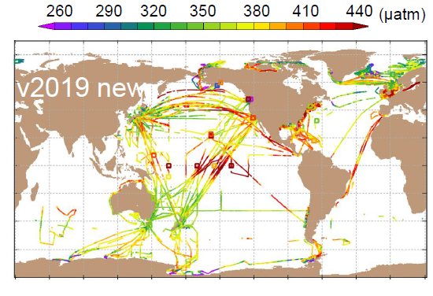
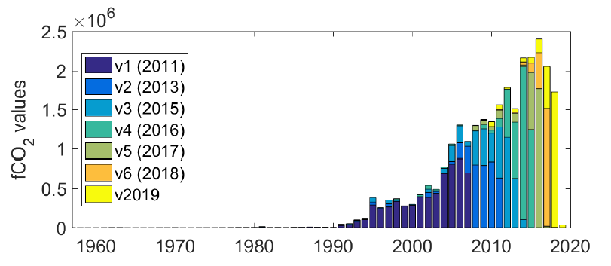
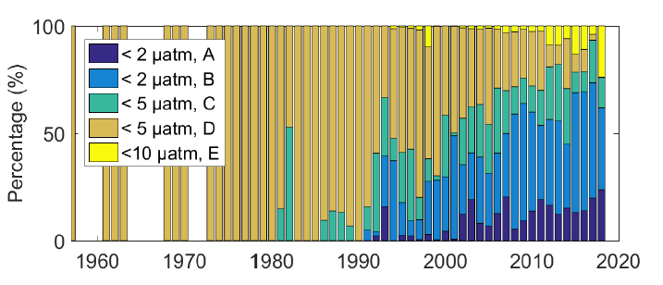
Global Carbon Data Management and Synthesis
Development of global data products
SOCATv2019 released with 2.3 million more measurements (top) than v5 (25.7 M total).
More than 50 peer-reviewed publications used the SOCAT product in 2019.
A primary source of data for the Global Carbon Program Budget assessment
Improved on an automated system for SOCATv2019+ data ingestion.
Bakker et al. 2018
Notes:
Synthesis PIs fill leadership roles in the development of the Surface Ocean Carbon Atlas (SOCAT). There was a major release of a new SOCAT data product in FY-19, SOCAT version 2019.
SOCAT is an international effort that strives to integrate all publicly available surface CO₂ data for the global surface oceans into a consolidated collection in a common format utilizing consistent QC procedures. SOCAT was motivated by requests from science groups over many years. This dataset increasingly serves as the foundation upon which the community evaluates the controls on air-sea CO₂ fluxes. The graph in the upper panel compares the number of measurements in the various releases of SOCAT. Version 6 has now been released with 25.7 million measurements, ~2.3 million more than were in version 6. The top figure shows the locations (and values) of the new data in v2019, while the middle panel histograms for the years in which the measurements of each SOCAT release were made and the bottom panel shows the percent of the measurements from each year that fall into categories of measurement uncertainty. Broadly, it can be seen that measurement uncertainty is decreasing over time (more green/blue colors). However, a recent increase in high uncertainty estimates (<10 uatm) can be attributed to the incorporation, for the first time ever, of float based pCO2 estimates that have the potential to greatly expand the spatial and seasonal coverage of the SOCAT data product.
The SOCAT data products are used extensively by the community, with over 50 publications registered as having used the product in so far in calendar year 2019. The data product is the primary source of data for the Global Carbon Program’s annual carbon budget, which is produced with DMSP coauthorship.
The continued success of the data ingestion framework developed for SOCAT on behalf and at the request of the global pCO₂ measuring and assessing community has inspired a planned extension of this work for ocean interior measurements. DMSP scientists are leveraging funding from the NOAA Ocean Acidification Program to build a data ingestion, initial QC, and metadata handling system in collaboration with and at the urging of the global ocean interior measurement program. This ambitious task has the potential to revolutionize the process by which ocean interior data becomes available globally, and allow the global carbon data measuring community (which often takes years to put data sets into global repositories and has, at times, inconsistent approaches to data QC) to approach the rapid (~6 month) timetable for public release of final carbon data that is currently attained by DMSP scientists. As was seen with SOCAT, it is anticipated that the proposed data ingestion framework would also greatly reduce the workload associated with tracking down, quality controlling, and assessing data sets from the global community.
Bakker, D. C. E., and Coauthors (including Wanninkhof), 2016: An update to the Surface Ocean CO2 Atlas (SOCAT version 3). Earth Syst. Sci. Data, 6, 69-90.
Update: Bakker and Coauthors, 2018, poster, SOCAT version 6: 23 million in situ surface ocean CO₂ observations.

Slide 3
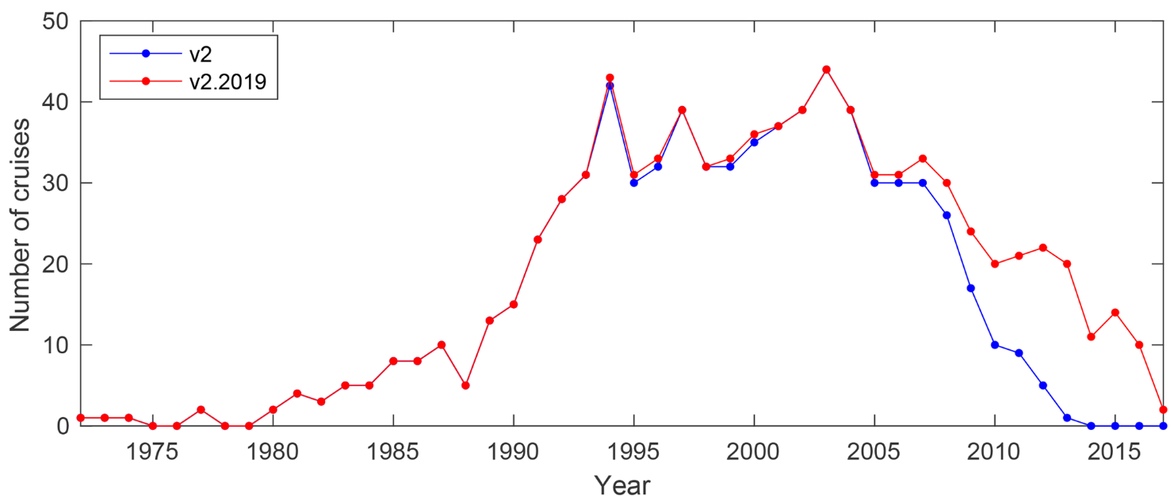
Global Carbon Data Management and Synthesis
Development of global data products
GLODAPv2.2019 released with 116 new cruises
>190 citations for the GLODAP 2016 product and >1200 for the 2004 product
Notes:
The first update to the 2016 release of the GLODAPv2 data product occurred in 2019. This update added 116 cruises, many of which contained fully (or over)-constrained carbonate chemistry. This represents a major leap forward in the ability of the community to release updated data products. The last update to this data product was in 2016, and the one before was in 2004. GLODAP is a highly influential data product with over 1400 combined citations despite the (rapidly improving) infrequency of release.
Olsen, A., and Coauthors, 2019: GLODAPv2.2019 – an update of GLODAPv2. Earth Syst. Sci. Data, 11, 1437-1461.

Slide 4
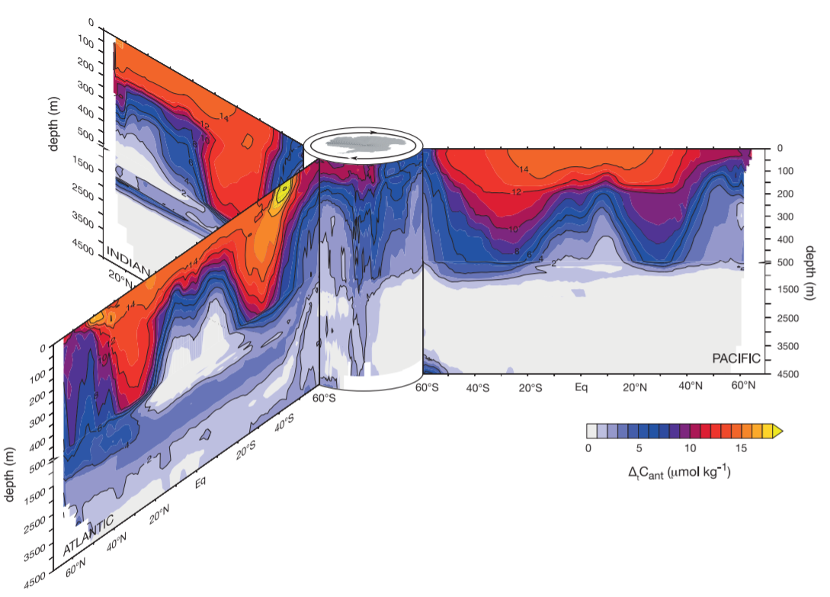
Global Carbon Data Management and Synthesis
Assessing interior anthropogenic ocean storage changes and their impacts
C_{anth} storages per 10ᵒ Latitude
band in PgC decade⁻¹
Gruber et al., Science, 2019
Notes:
Ocean carbon concentrations have large natural variability from short term, seasonal, and interannual cycles. Disentangling anthropogenic carbon uptake from natural variability is a major challenge tackled by DMSP scientists. DMSP scientists can use changes in the empirical relationships between carbon and these other properties to estimate the anthropogenic portion of carbon concentration changes.
FY-19 saw the publication of two major anthropogenic carbon concentrations assessments with DMSP contributions. The figure in this slide is showing the increase in anthropogenic carbon concentrations from 1994 through 2007 in three major ocean basins, effectively updating the Sabine et al., 2004 estimates for another decade. This approach relies upon having a global and secondarily quality controlled data product so it depends directly on DMSP efforts and is as far behind as the GLODAP releases.
Gruber, N., and Coauthors, 2019: The oceanic sink for anthropogenic CO₂; from 1994 to 2007. Science, 363, 119, 10.1126/science.aau51533.
A separate DMSP-led effort published in FY-19 circumvented this limitation to update the Pacific Ocean anthropogenic carbon inventory estimates through 2015. It did this by exclusively relying on the highly quality controlled (by DMSP funded efforts) data available along 14 Pacific sections. This release represents the synthesis of ~30 years of hydrographic data, and presents new methods for making updated Pacific Canth estimates available to scientists and researchers in other communities going forward.
Carter, B. R., and Coauthors, 2019a: Pacific Anthropogenic Carbon Between 1991 and 2017. Global Biogeochem. Cycles, 2018GB006154, doi:10.1029/2018GB006154. https://journals.ametsoc.org/doi/10.1175/2018BAMSStateoftheClimate.1 (Accessed June 4, 2019).

Slide 5
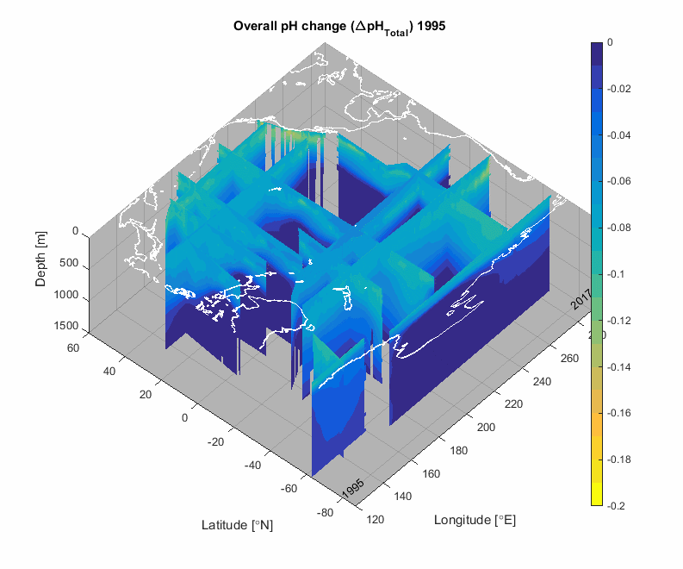
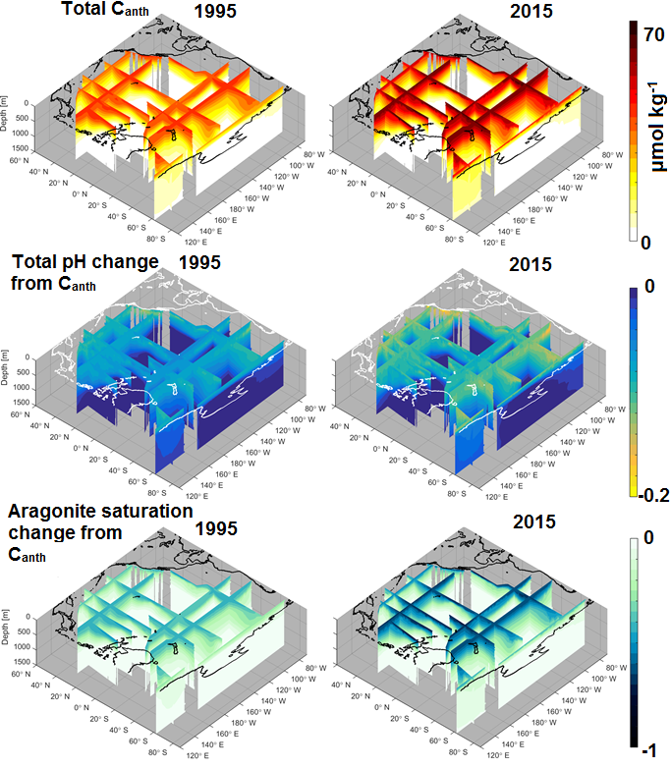
Global Carbon Data Management and Synthesis
Assessing interior anthropogenic ocean storage changes and their impacts
Notes:
Estimating anthropogenic carbon concentrations is critical because it allows the impacts of human activities on seawater pH and carbonate mineral saturation to be calculated (i.e. Ocean Acidification).
<<Is the animation working? If not, skip to 2.>>
1. This animation shows the overall impact of anthropogenic Canth on seawater pH and how it has changed between 1995 and 2015 along 14 hydrographic sections as a result of human CO₂ emissions. It can be seen how the largest rates of Ocean Acidification are found at the surface in the high-latitudes and just below the surface off the US West Coast. This is because these waters are naturally enriched in dissolved inorganic carbon, and therefore are the most affected by further anthropogenic carbon accumulation. A paper in review by DMSP researchers explores this natural amplification of anthropogenic ocean acidification.
<<If you read 1. skip to 3.>>
2. This plot shows the overall impact of anthropogenic Canth on seawater pH and how it has changed from the preindustrial era to 1995 as a result of human CO₂ emissions. It can be seen how the largest rates of Ocean Acidification are found at the surface in the high-latitudes and just below the surface off the US West Coast. This is because these waters are naturally enriched in dissolved inorganic carbon, and therefore are the most affected by further anthropogenic carbon accumulation.
<< If you have animations off, skip to the next slide… otherwise hit advance to trigger the animation>>
These are calculations of the overall anthropogenic carbon (on top) in 1995 (left) and 2015 (right) along all 14 sections, and the impacts of the anthropogenic carbon on seawater pH (middle) and aragonite saturation state (bottom).
Animation released as a supplement for:
Carter, B. R., and Coauthors, 2019a: Pacific Anthropogenic Carbon Between 1991 and 2017. Global Biogeochem. Cycles, 2018GB006154, doi:10.1029/2018GB006154. https://journals.ametsoc.org/doi/10.1175/2018BAMSStateoftheClimate.1 (Accessed June 4, 2019).

Slide 6
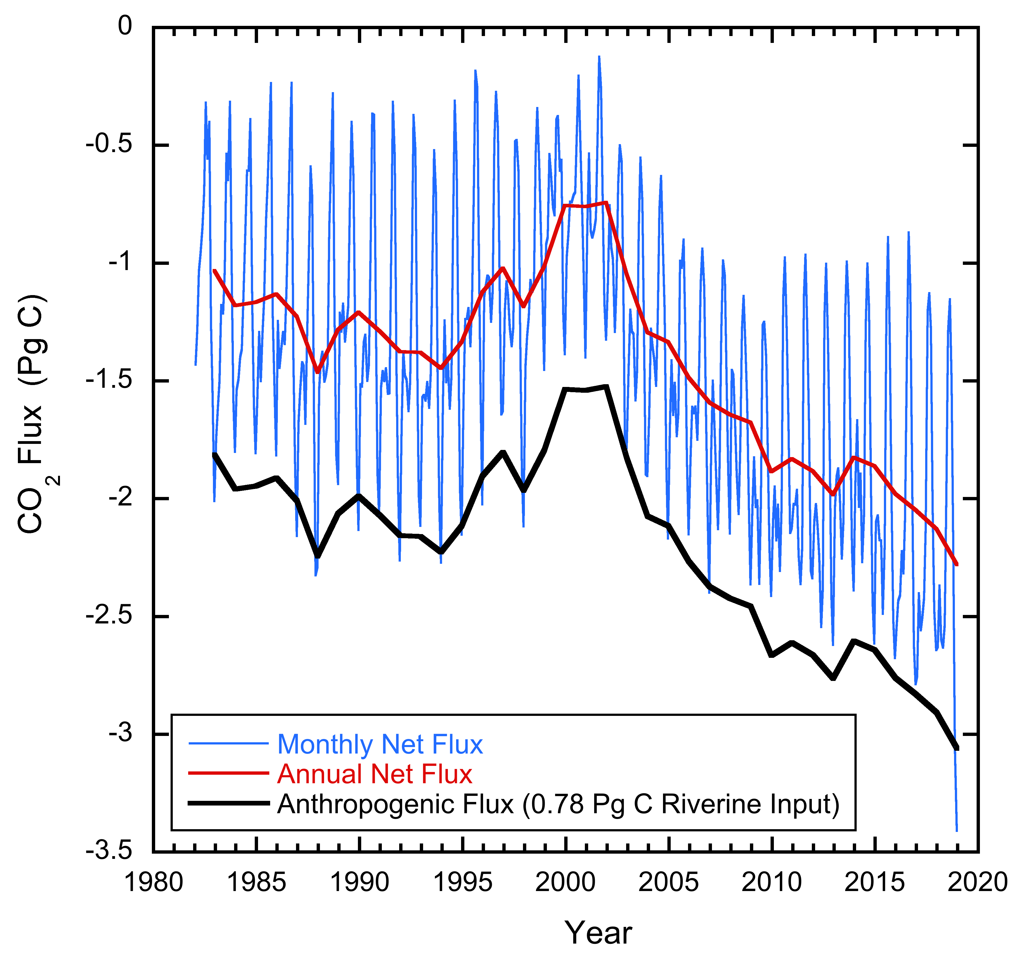
Global Carbon Data Management and Synthesis
Use of data products
Continued to use SOCAT and related data products for novel research into quantifying air-sea pCO₂ flux trends.
Feely et al., 2019
Notes:
DMSP researchers continue to conduct novel research using the data products they create. These two figures show natural CO₂ flux over time and the inferred net anthropogenic flux (after adjusting for riverine contributions), both from the ocean generally on the left and from the Caribbean on the right. The figure on the left shows the impact of large scale climate reorganizations, while the figure on the left demonstrates regional-scale anthropogenic carbon flux variability. These figures are featured in two 2019 DMSP PI publications.
Feely, R. A., R. Wanninkhof, B. R. Carter, P. Landshutzer, A. J. Sutton, C. Cosca, and J. A. Triñanes, 2019: Global ocean carbon cycle in Global Oceans State of Climate 2018, R. Lumpkin, Ed.
On the right is shown attribution of monthly pCO₂ changes in the Caribbean Sea from 2002-2018. The 16-year average monthly change in fCO₂, ∂fCO_{2w} (solid black line) is deconvolved into temperature, (red), gas exchange, (blue), and biology and mixing (B&M) components, (green). The change is that from the preceding month. For example, the change in April (4) is the difference between March and April.
Wanninkhof, R., J. Triñanes, G. Park, D. Gledhill, and A. Olsen, 2019b: Large Decadal Changes in Air‐Sea CO₂ Fluxes in the Caribbean Sea. J. Geophys. Res. Ocean., 2019JC015366, doi:10.1029/2019JC015366. https://onlinelibrary.wiley.com/doi/abs/10.1029/2019JC015366 (Accessed December 3, 2019).

Slide 7
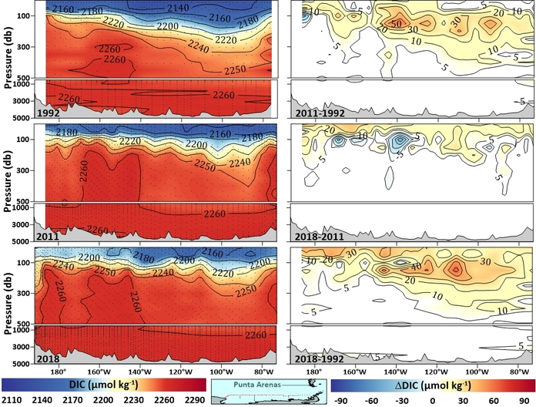
Global Carbon Data Management and Synthesis
Ongoing QC and outreach efforts
Proposed, organized, and hosted (at WHOI) a working group on carbonate measurement intercomparability
QC’d carbon data from numerous Volunteer Observing Ships and 2 repeat hydrography cruise legs occupied in the Pacific in FY-19
Mentored students, gave public talks, and served on science steering committees.
Notes:
DMSP research in FY-18 revealed an important and consistent discrepancy between measured and calculated values for carbonate chemistry properties that persists even among the best laboratories making carbonate chemistry measurements. Therefore a working group was proposed to OCB and funded for FYs19 and 20. The first meeting of the resulting Ocean Carbonate System Intercomparison Forum (OCSIF) was hosted (by DMSP scientists) in WHOI in the summer of FY-19, and has led to a proposal for an inter-laboratory comparison project (that aims to reveal the reason for the observed discrepancy) planned for FY20.
Synthesis PIs actively produce, QC, and compile datasets and make these datasets available online. In addition, Synthesis labs participated in gathering two repeat hydrographic cruises in FY19. In FY19, final quality control was completed for I07 and I06 in the Indian Ocean, and S04P (a cruise in the Pacific sector of the Southern Ocean that was held in FY-18). The final stage of quality control is cross calibration of cruise data against data from earlier cruises, data from nearby cruises, and estimated data from calculations using other measured parameters. By these accounts, the datasets produced in FY19 appear excellent. Sections are plotted of total dissolved inorganic carbon (left) and differences between concentrations measured in the years indicated along the S04P section.
DMSP scientists continued to give public, scientific talks, serve on committees, and give interviews on DMSP research in FY-1.

